Slide 1
Community Service Project
MENTOR TRAINING - DAY 3

Slide 2
Welcome | 15 | 90 | 10:00 - 11:30pm
Ice Breaker | 10
Introduction | 20
Recap | 20
Agenda | 5
Why are you here and expectations from the program | 30
Break | 15 | 15 | 11:30 11:45
Identifying issues around us and mapping them to SDGs Identifying the problem and solution | 75 | 75 | 11:45 - 1:pm
Lunch Break | 60 | 60 | 1:00 pm - 2:00 pm
Warm Up | 15 - 20 | 105 | 2:00 pm - 3:45 pm
Problem tree analysis , Framing the problem statement and research question | 60-70
Regrouping and sharing | 15 - 20
Break | 15 | 15 | 3:45 pm - 4:00 pm
Who is a Mentor/Guide | 45 | 90 | 4:00 pm - 4:30 pm
Actions for a Mentor/Guide | 20
Recall + Homework | 25

Slide 3
Session 1
90 mins
Welcome
Introduction
Agenda
Why are they here and the expectations from the program

Slide 4
Welcome
Welcome to Day 3 of the Mentors Training Session
Introduce Team
Things to Remember
A book
Let us all be on the same page

Slide 5
Ice Breaker (SWITCH ON AND OFF)
It’s activity time
Let’s break some ice :)
Switch on and off your cameras if……..

Slide 6
Ice Breaker (WEATHER REPORT)
It’s activity time
Let’s know how you are feeling today in comparison to the weather.
Describe your mood as a weather report
Eg: I am feeling bright and sunny or I am feeling dull and rainy etcs

Slide 7
Introductions (Comment on chat…)
It’s time to get to know each other
Let’s share our name
Which college are we working in
What subject are we teaching
What do you remember about the last 2 days of the training we did
2 mins to think
Comment on chat or unmute and share
Eg: My name is _____________ and I work with _________ and I teach _________________. What I remember of the training is ___________

Slide 8
Recap (Comment on chat…)
We spoke about the
What is community service?
The objectives of this program
How will this program get implemented
We also briefly went through
SDGs
Andhra and SDG
Reports and surveys and why it is collected
Why is this program being done
How to find out problems and solutions
Who are the two people involved in this program?
Role of Youth
Role of Mentor

Slide 9
Agenda
Why You and Why are you here?
Your Expectations of the program
8 weeks of the program for the students
Experience a section of the student curriculum
*Identifying issues around us through observation and experience
* Shortlisting problems
*Mapping it to SDGs
* Problem tree analysis, Framing the problem statement and research question
Introduction to who is a facilitator and some facilitator actions

Slide 10
What do you think are the qualities a student should possess to go through this project or will develop during the project?
https://www.menti.com/al2p1fx5eo8x | The voting code 4980 3663
Click on the link and add the voting code - 4980 3663
Share in your responses
5 mins to respond
Time’s Up
Let’s look at your responses
Qualities a student should possess or will develop through the project
Notes:
Userid - askcurlyhead@gmail.com
Pass - CDP2022

Slide 11
Do You Agree
For the students to develop these qualities they have to be mentored by teachers who have some of these qualities right. Do you agree?
Please give a thumbs up.

Slide 12
Students
Mentors
Master Trainers

Slide 13
Mentors
What do you think are the qualities mentors should possess for a successful completion of this program?
Share in your responses
5 mins to respond
Time’s Up
Let’s look at your responses
These are the qualities a mentors trainer should possess

Slide 14
Leader
Changemaker
Empower
Mentor
Facilitator
Entrepreneurial
Inspirational

Slide 15
Role of a mentor
Assigned with 10 to 15 students
Faculty-mentor for the group
In-charge for the learning activities of the students
Comprehensive and continuous assessment of the students.
Meet the students before they begin their projects
Handover the student curriculum and the log book template
Be available on calls for the students to ask questions/doubts
Meet them mid project to see progress
Check on log completions
Approve project completion
Grade the project

Slide 16
Expectations from us?
Do you have any expectations from us? - https://www.menti.com/alxnyzc48x3t
Code: 8384 6571
Click on the link and code - 8384 6571
Share in your responses
5 mins to respond
Time’s Up
Let’s look at your responses
Thank you for responding
We are all work in progress, will take back the expectations and see how we can work around it

Slide 17
BREAK
15 MINS

Slide 18
Session 2
90 mins
Identifying Issues Around Us
Shortlisting problems
Mapping to SDGs

Slide 19
What should you do or know? (Comment on chat…)
If you as MENTORS have to support our students in the best possible way, what should you do and know?
Type in the chat box
Know student curriculum
Project overview
Understand all aspects of the project execution

Slide 20
8 Weeks of the Program
Spend 5 mins to go through it

Slide 21
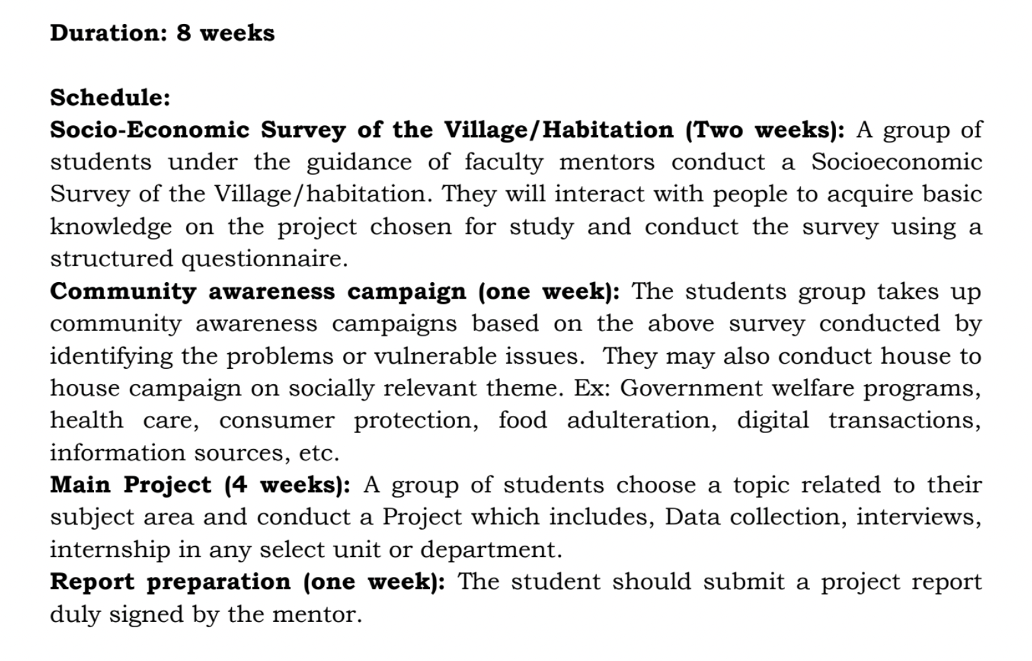

Slide 22
Mentors Roles - During training
Student
Guide

Slide 23
Are you Ready??

Slide 24
Week 1 - Socio Economic Survey (Village/Habituation)
What a problem is and how to identify a problem (last session)
Identify Problem Through Observations and Experiences (Next Step)

Slide 25
Community Around You

Slide 26
Visualise
Community
College
Home

Slide 27
Note down your observations
Note down your observations on your book - 10 mins
Thumbs up once done
Thank you for being a part of this visualisation activity
You have now identified problems through your observations and experiences
Note: Students will also do a similar exercise to identify issues around them

Slide 28
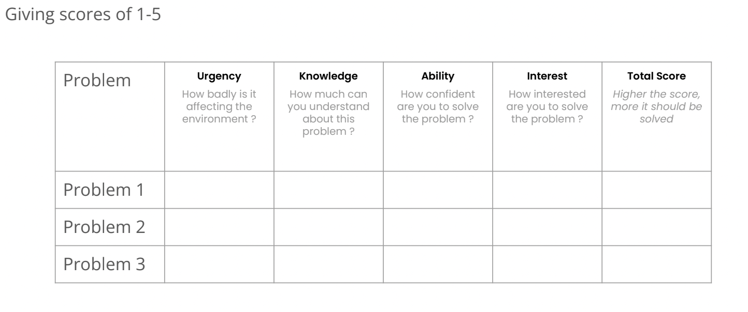
Score problems identified - 10 mins

Slide 29
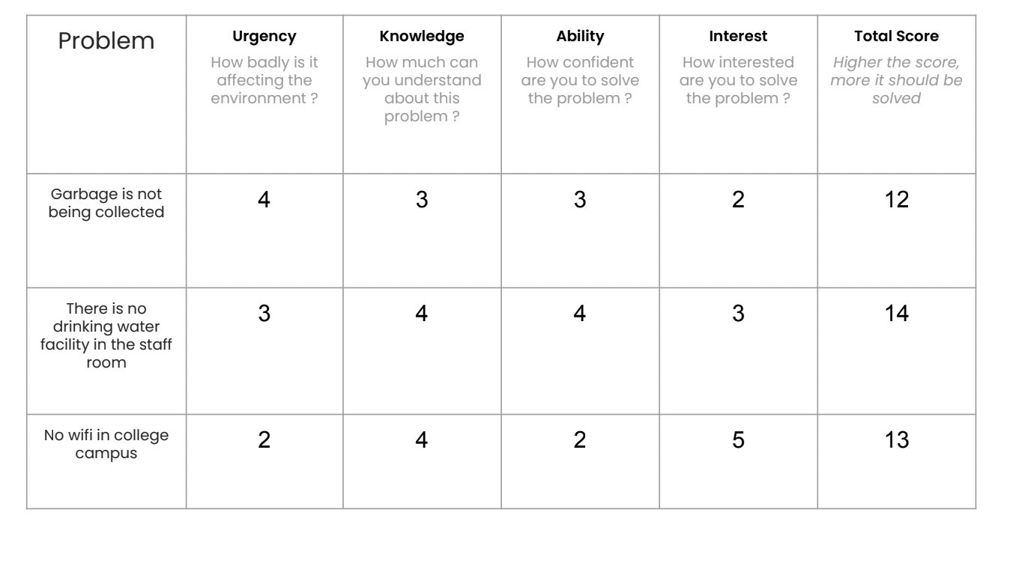

Slide 30
Short list top 5 - 5 mins
Once you are done, shortlist top 5 problems on the basis of your scoring.
Share your top 5 in the chat box

Slide 31
Week 1 - Socio Economic Survey (Village/Habituation)
Identify Problem Through Observations and Experiences (Done)
Map shortlisted problems to SDGs (Next)

Slide 32
Map top 5 to SDGs - 10 mins
Look at your top 5 problems
Map them to the goal it falls under (SDGs) - 10 mins
Eg:
Which goal do you think these will fall under?
Garbage is not being collected from house and there is pile of Garbage in the junction
No clean drinking water in the staffroom
Give us a thumbs up once done
Share your top 2 problems with SDGs on the chat

Slide 34
Week 1 - Socio Economic Survey (Village/Habituation)
Identify Problem Through Observations and Experiences (Done)
Shortlisted top 5 and Mapped shortlisted problems to SDGs (done)
Note: Students will also do a similar exercise to shortlist top 5 problems

Slide 35
BREAK
60 MINS

Slide 36
Session 3
90 mins
Problem Tree Analysis
Problem Statement
Research Question

Slide 37
Warm Up Activity
Draw 30 circles like this in your books
Give a Thumbs up once done or put
in chat box

Slide 38
30 circle challenge
In 3 mins
Draw as many circular things
using the blank circles.
You can draw inside the circles
or make the circle into something else.
Anything is allowed as long as they
use the circles in their drawings.
Try and keep your video on if possible

Slide 39
Time’s Up
Show what you have made keeping camera on if possible
Answer the below two questions in the chat box..
How many circular objects were you able to come up with?
What is the most surprising or unique object you could think of?
Thank you :)

Slide 40
Problem Tree Analysis
Take a minute to finalise 1 problem among the top 5 to work with.
With the 1 identified problem we will be doing a problem tree analysis
What is problem tree analysis
Before beginning a project it’s important to
Problem Tree Analysis is central to many forms of project planning.
Problem tree analysis (also called Situational analysis or just Problem analysis) helps to find solutions by mapping out the anatomy of cause and effect around an issue in a similar way to a Mind map, but with more structure.

Slide 41
Identify what is the problem
What is causing it
What are the effects of the problem
Before beginning a project it’s important to

Slide 42
Effects
Identified Problem
Causes
Problem Tree Analysis

Slide 43
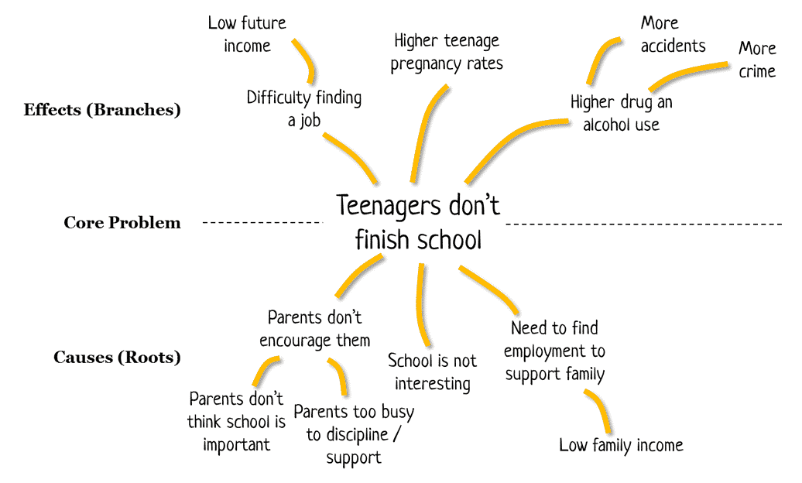
Problem Tree Analysis

Slide 44
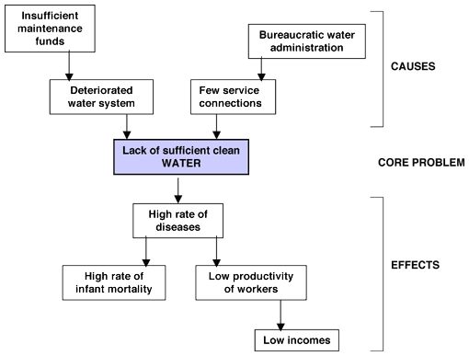
Problem Tree Analysis

Slide 45
4. Solutions (5 mins)
New leaf/ Additional branches
3. Effects (10 mins)
Branches
Identified Problem
Main Trunk
2. Causes (10 mins)
Roots
Problem Tree Analysis

Slide 46
Share Your Problem Tree Analysis
Take 5 mins to go through your Problem Tree and add in if any points are missed out
Give us a done or thumbs up
Let’s share our Problem Tree
Let’s take 10 mins to go through the problem trees shared

Slide 47
Now that we have identified the problem, it's causes and effects.
What will the next step be, before we begin research on it?
Please share your responses on the chat box
It’s important to have a problem statement
We did look at what a problem statement is in the previous session.
Can one of you recall what a problem statement is
Causes+Effects+Users Affected= Problem Statement
Eg: In the last 5 years enrolment rate in high school has dropped by 30% in town x due to lack of higher education options in the surrounding
Eg: There is high drug use amidst the Teenagers and they don't finish school due to lack of family income.

Slide 48
Framing your problem statement
Causes+Effects+Users Affected= Problem Statement
Let’s look at our problem tree and choose 1 top cause/ personal cause and effect that we think we want to address
Take 10 mins to work on the Problem statement
Give a done or thumbs up once done
Share Problem statement on the chat

Slide 49
Framing your research question
What is research question?
Answer: A question that addresses an issue or a problem which through analysis and interpretation of data, is answered in the study's conclusion. It is an important question as it sets foundation for research
What is the difference between research question and problem statement?
Answer: Merely explains the context of the problem with its causes and effects. However, Research question will help you research the problem and come to a conclusion. It is the basis for setting hypotheses and by the end of the research you either prove or disprove the hypothesis.

Slide 50
Eg: In the last 5 years enrolment rate in high school has dropped in town x due to lack of higher education options in the surrounding
Research question: Is the lack of higher education options in the surrounding affecting enrolment rate?
Eg: There is high drug use amidst the Teenagers and they don't finish school due to lack of family income.
Research question: Is lack of family income in village x leading to teenagers dropping out of school?
Or
There is increase in drug use among teenagers because they have dropped out school?

Slide 51
Identify what is the problem
Problem tree analysis - What is causing it, What are the effects of the problem
Framing a problem statement and research question
You have 10 mins to work on your research question
Give a thumbs up once done
Thank you teachers for being a part of this activity
Take 5 mins to go through all the steps you have taken so far

Slide 52
What next?
What do you think is the next step in this project?
Share on chat
We will be working on the next steps in the next session which is Day 4

Slide 53
BREAK
15 MINS

Slide 54
Session 4
90 mins
Who is a Guide/Mentor
Guide Actions
Recall
Closing

Slide 55
Who is a Guide/mentor
Name of the Mentor

Slide 56
Visualise

Slide 57
Who is a Guide
Dos
Dos, inside the Guide
Name of the Guide

Slide 58
Who is a Guide
Dos
Dos, inside the Guide
Donts
Donts, outside the Guide
Name of the Guide

Slide 59
Dos
Donts

Slide 60
What will you have to do as guides to ensure great learning for the students?

Slide 61
Guide Actions
Appreciate their work
Make students feel comfortable
Being calm & composed
Communicating clearly
Being patient
Being interactive
Asking right questions when they come to you
Do not be judgemental
Do a check on how they are feeling about the project
Check for Understanding and progress

Slide 62
Recall
Why You and Why are you here?
Your Expectations of the program
8 weeks of the program for the students
Experience a section of the student curriculum
*Identifying issues around us through observation and experience
* Shortlisting problems
*Mapping it to SDGs
* Problem tree analysis, Framing the problem statement and research question
Introduction to who is a guide and some guide actions

Slide 63
Closing
Poll: How are you feeling? (Excited, bored, tired, energetic)
Point 1: CBPR
Point 2: Feedback form

Slide 64
QnA
10 MINS

Slide 65
See You next session

